Slide 1

GAME STOP Pokemon & Snake
Tae Kim / Alice Nam / John Rock
Nayoung Kwon / Kevin Hartanto

Slide 2
Table of Contents
01
02
03
04
Part 1 : Introduction
Data Processing & Modeling
Convolutional Neural Network
Pokemon Image Classification
Part 2 : Introduction
Suggestions
Reinforcement Learning
Snake Game

Slide 3
02
POKEMON
Convolutional Neural Network
GOAL : Build deep learning model to predict first generation of Pokémon name from the pictures

Slide 4

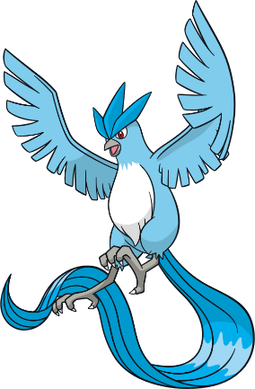
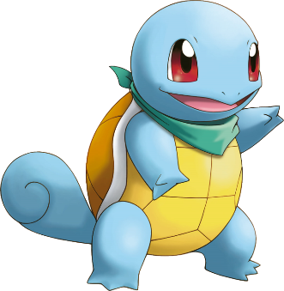
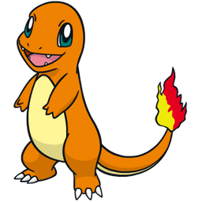
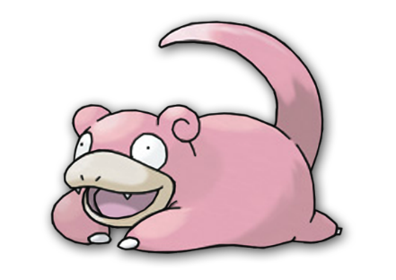
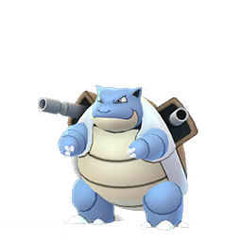


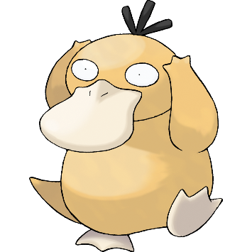

Pokemon Friends
⭐ Randomly
chose 8 Pokemons
of our choice.
⭐ Blastoise
and Psyduck were
added to make
little confusion when classifying Squirtle
and Pikachu.
Squirtle
Slowpoke
Pikachu
Charmander
Articuno
Blastoise
Psyduck
Eevee
Snorlax
Ditto

Slide 5
Model Breakdown
1
2
3
Sequential_3_input
Sequential_3
Preprocessing_2
: Sequential
✅ Randomflip randomrotation randomzoom
rescaling
: InputLayer
5
4
Max_pooling2d_6
Conv2d_6
: maxpooling2d
: conv2d
✅ Activation : Relu
6
7
8
Conv2d_7
Conv2d_8
: conv2d,
✅ Activation :ReLU
Max_pooling2d_7
✅ Activation :ReLU
: conv2d,
: maxpooling2d

Slide 6
Model Breakdown
9
10
11
Max_pooling2d_8
dropout_4
flatten_2
: maxpooling2d
: dropout
: flatten
13
12
Batch_normalization_2
dense_4
: batchnormalization
: dense
✅ Activation : Relu
14
15
✅ Activation : Softmax
Dropout_5
Dense_5
: dropout
: dense

Slide 7
Model evaluation
Accuracy
87%
With 30 epochs
Loss
54%
With 30 epochs

Slide 8
03
SNAKE GAME
Reinforcement Learning
GOAL : Design an optimal strategy for a (AI) to play "Snake Game" using activation function and investigate how to maximize reinforcement learning from the "Snake Game"

Slide 9
description
"The Snake" explores to find food and eats the food and thereby grows larger
Background : 10X10 playing field with 'x' direction of the snake and 'y' direction of the snake
Action, state and reward rules
*Snake is always moving

Slide 10
Features (Toy Example)
01
02
03
Actions
State
Rewards
Snake move left : -1
Snake move right : 1
Snake move forward : 0
Apple is above / right / below / left of the snake : 0 or 1
Obstacle directly above / right / below / left of the snake : 0 or 1
Snake direction is up / right / down / left : 0 or 1
Snake eats an apple : 10
Snake comes closer to the apple : 1
Snake goes away from the apple : -1
Snake dies : -10

Slide 11
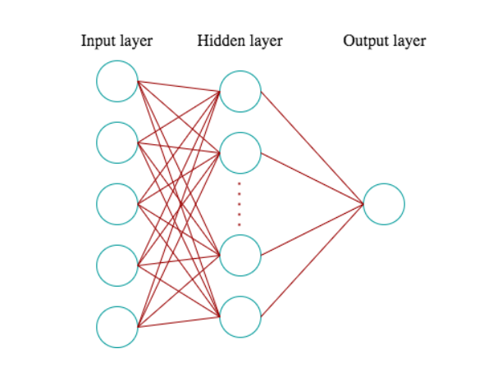
Input layer
✔ Activation Function : ReLU
Hidden layer
Two Fully connected layer of
size 10 nodes
✔ Activation Function :
TanH, Bounded Leaky ReLU
Output layer
✔ Activation Function : Softmax

Slide 12
Final reward? “cumulative”
Earnings
Risks
Snake eats an apple
Snake comes closer to an apple
Snake dies
Snake goes away form an apple

Slide 13
Suggestions
Objective: To make better model
New state
When snake perform action and get reward
Calculate
All the probabilities of cells in that state
Next state
Giving probabilities in each cell so snake can take a peek
Act like GPS
Snake will have to follow the path that has the highest probabilities

Slide 14
Questions ?

Slide 15
Resources
Sutton, R. S., & Barto, A. G. (2014,2015). Reinforcement Learning: An Introduction (Second ed.). The MIT Press. doi:https://web.stanford.edu/class/psych209/Readings/SuttonBartoIPRLBook2ndEd.pdf
MANCHO, R. (2019, June 20). Implementation of the Environment of a Practical Work in a Computational Intelligence Course. Retrieved April 10, 2021, from https://upcommons.upc.edu/bitstream/handle/2117/168130/145703.pdf?sequence=1&isAllowed=y

